Slide 1

Introduction to MySQL

Slide 2
MySQL Roadmap
Week 2
MySQL Functions
Grouping
Joins
Table aliases
Sub-selects
Special Functionality
Views/Triggers
Obtaining Metadata
Transactions and Locking
MySQL Replication
MySQL in Data Science
MySQL functions for Data Science
Lab 2

Slide 3
MySQL functions
MySQL provides the following types of functions that you can use in your queries:
Numeric
Character
Date and time
Functions handling NULL values
Aggregate

Slide 4
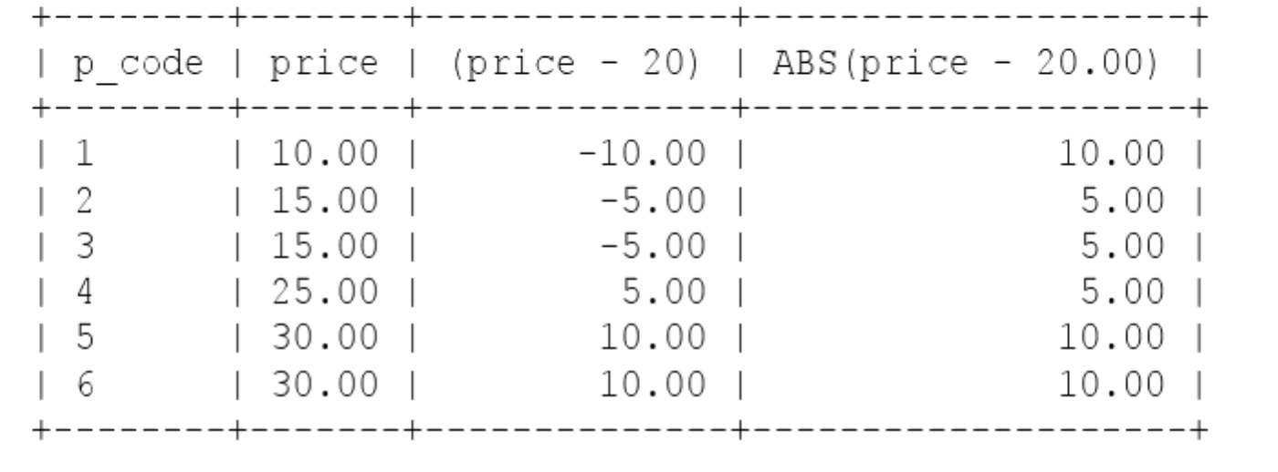
MySQL functions - Numeric
ABS
ABS(n) returns absolute value of n. The following query returns the absolute value (price – 20.00) as the third column:

Slide 5
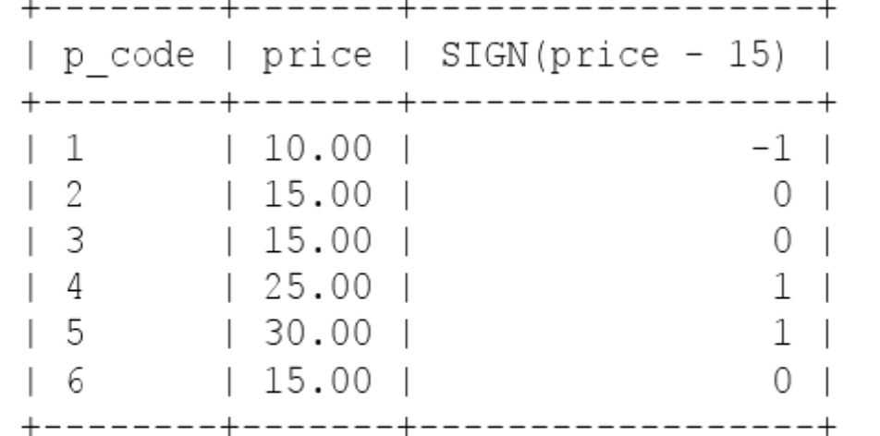
MySQL functions - Numeric
SIGN
SIGN(n) returns a value indicting a sign of n. The following query uses SIGN to return the sign of (price – 15)

Slide 6
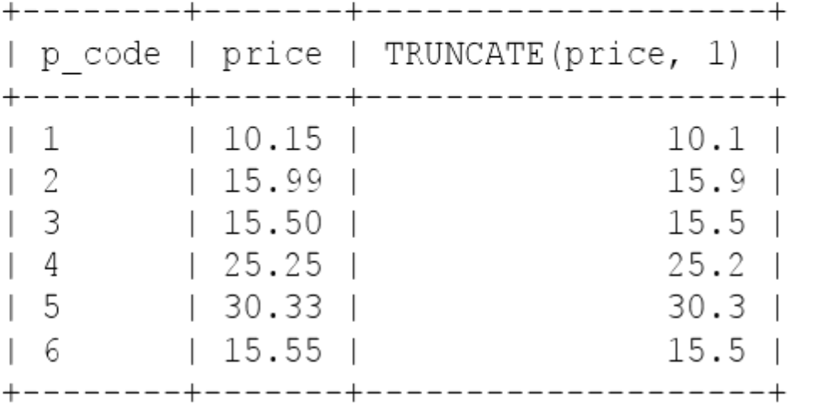
MySQL functions - Numeric
TRUNCATE
TRUNCATE(n,d) returns a number truncated to a certain number of decimal places.
Argument n is the number to truncate and d the number of decimal places

Slide 7
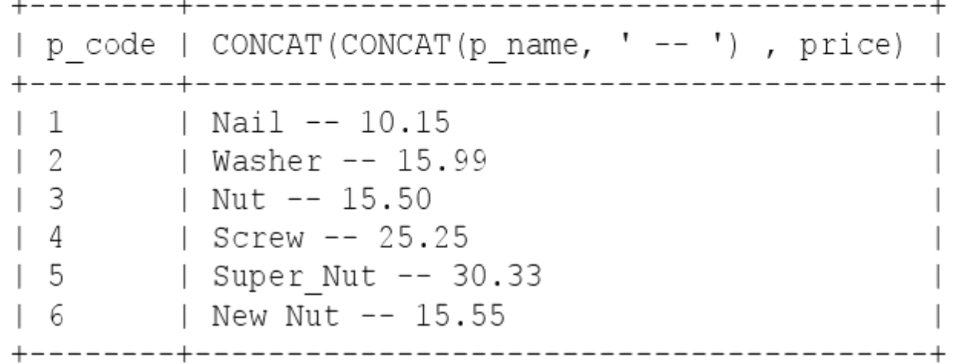
MySQL functions - Character
CONCAT
CONCAT(string1, string2) concatenates string1 and string2 and returns the result. If you pass a number as an argument, the number will first be converted to a string. Here we are concatenating three strings:

Slide 8
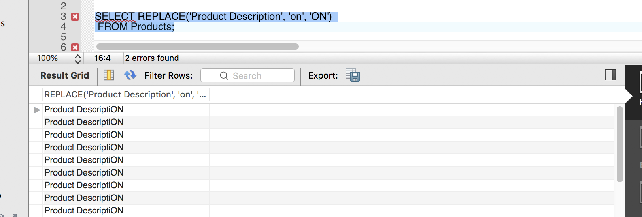
MySQL functions - Character
REPLACE(str, find_string, replace_with)
Replaces all occurrences of a substring within a string
Example: we are replacing string ‘on’ within string ‘Product Description’ with string ‘ON’

Slide 9
MySQL functions - Character
SET SQL_SAFE_UPDATES = 0;
UPDATE Products SET ProductName = REPLACE(ProductName, 'Chai', 'GoodChai');
select * from Products where ProductName like '%Chai%';

Slide 10
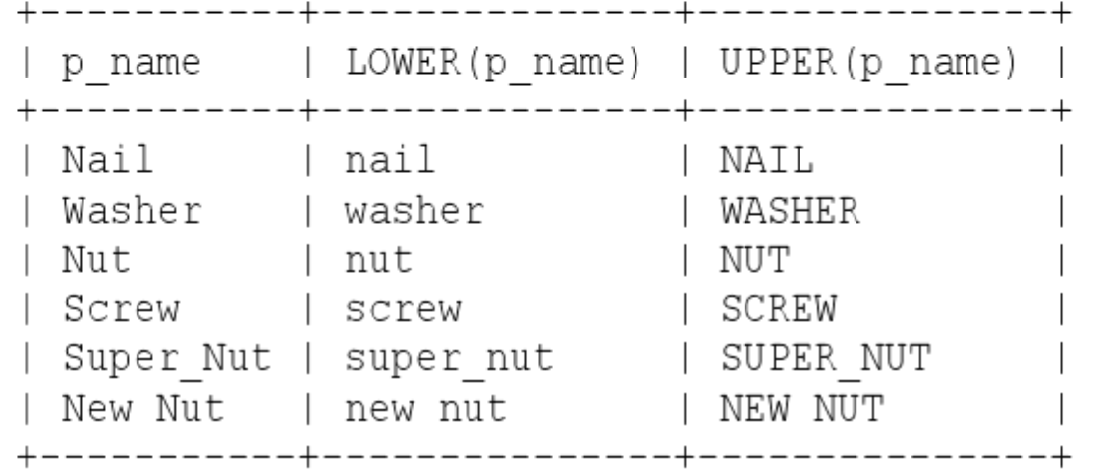
MySQL functions - Character
LOWER(str) converts str to lowercase and UPPER(str) converts str to uppercase:

Slide 11
MySQL functions - Character
LOWER(str) converts str to lowercase and UPPER(str) converts str to uppercase:
Describe CUSTOMER
SELECT ContactName, LOWER(ContactName), UPPER(ContactName) from Customers;

Slide 12

MySQL Character Set
Character set: characters that are legal in a string
Character belongs to a specific character set
Coalition: named collating sequence
Defines character sort order
Governs how individual characters and character string can be compared to each other
Column definitions for string data types can specify a character set of collation of the column

Slide 13
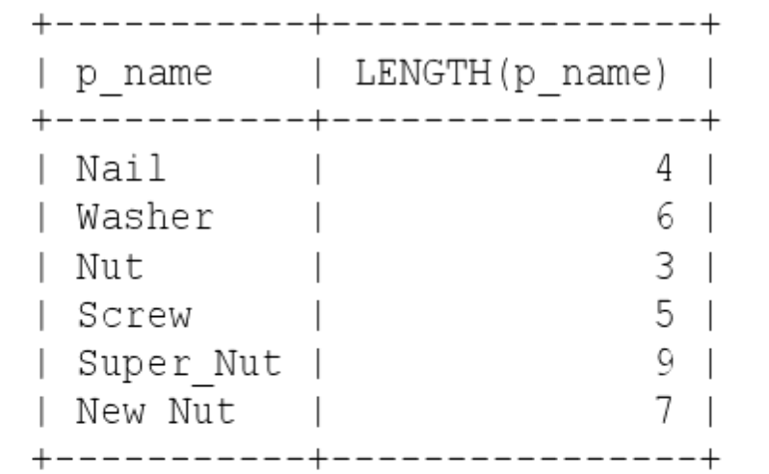
MySQL functions - Character
LENGTH(str) returns the length of string str. The length of a string is the number of characters in it. This query returns the length of p_name as the

Slide 14
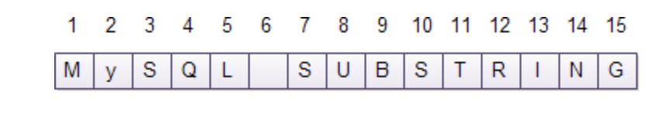
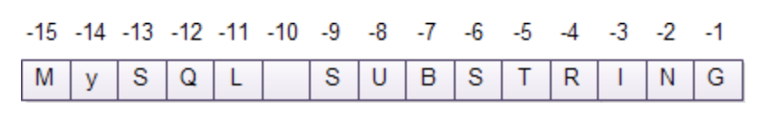
MySQL functions - Character
SUBSTR
(str,start_position,[length]) returns a substring of str, starting from the position indicated by start_position.
If length is not specified, the function returns a substring from start_position to the last character in str.
If length present, function returns a substring which is length characters long starting from start_position.
If length is less than 1, the function returns an empty string.

Slide 15
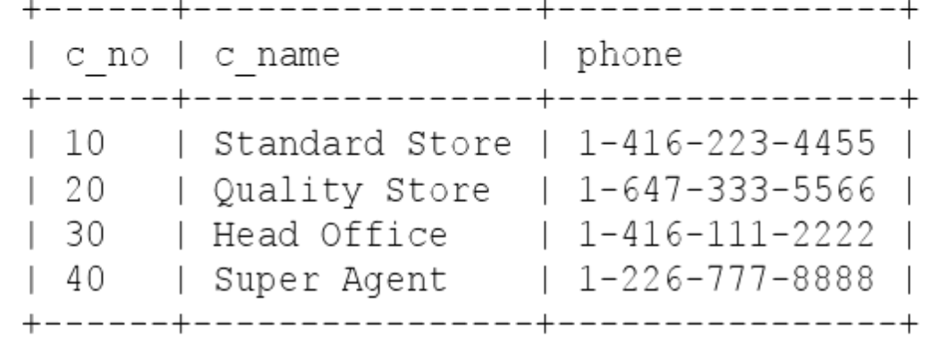
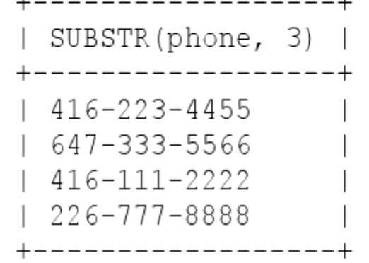
MySQL functions – Character

Slide 16
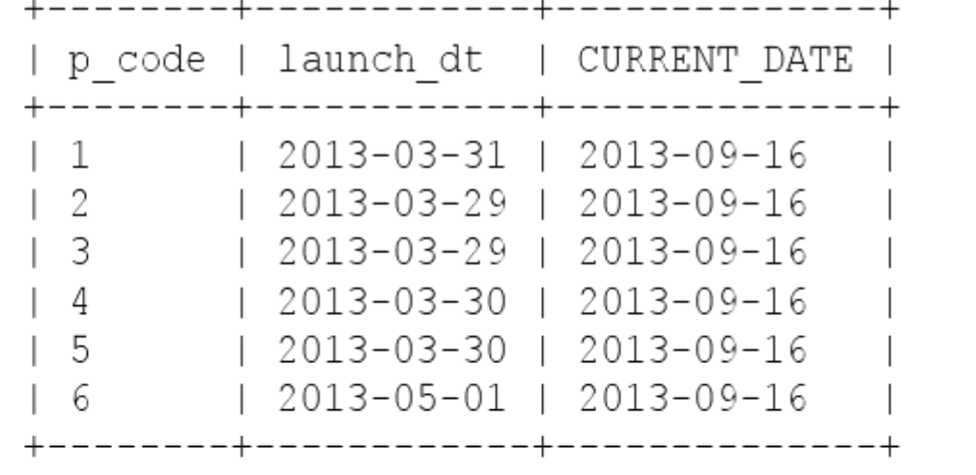
MySQL functions – Date and Time
CURRENT_DATE
CURRENT_DATE() returns the current date

Slide 17
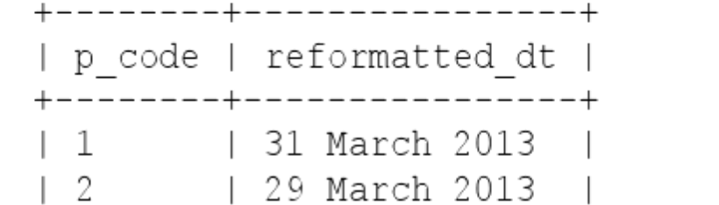
MySQL functions – Date and Time
DATE_FORMAT
DATE_FORMAT(dt,fmt_specifier)
Converts a date (dt) to a string in the format specified by fmt_specifier . Here we format a column with a format specifier as follows:
%d – the day of the month
%M – the long name of the month
%Y – the year
https://www.techonthenet.com/mysql/functions/date_format.php

Slide 18
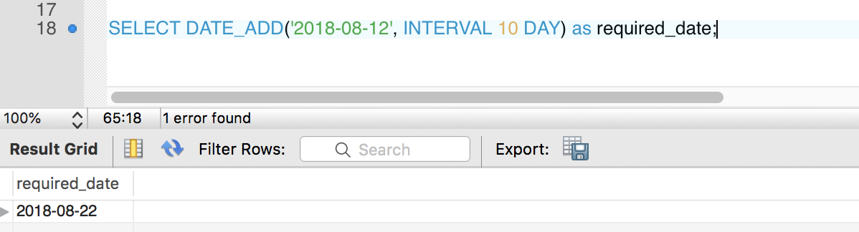
MySQL functions – Date and Time
DATE_ADD
DATE_ADD(date, INTERVAL expr unit)
Adds values (as intervals) to date value
Date – a date value
INTERVAL – keyword
expr – a date or datetime expression or a number
Unit – unit described in a table
Example: add 10 days to specified date:
https://www.techonthenet.com/mysql/functions/date_format.php

Slide 19
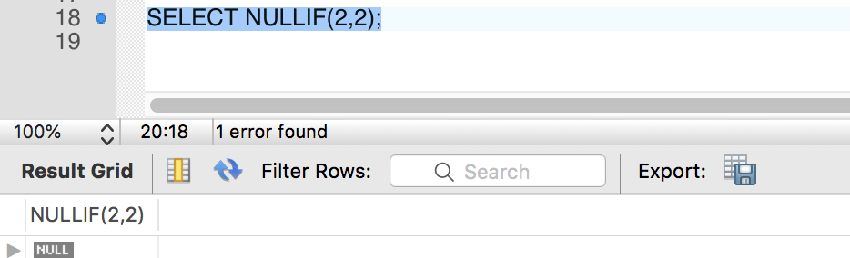
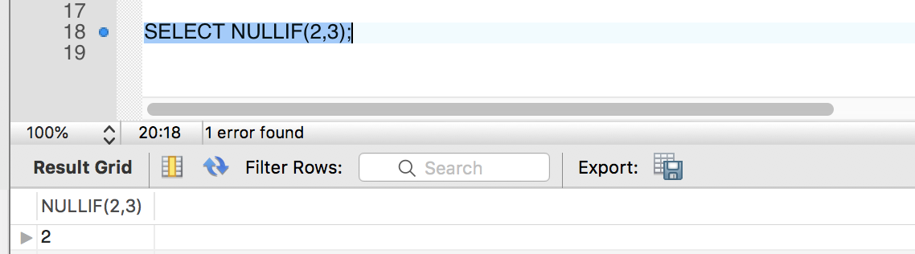
MySQL functions – NULL-related
NULLIF
NULLIF (expr1, expr2) compares expr1 and expr2.
If they are equal, the function returns NULL.
If they are not equal, the function returns expr1

Slide 20
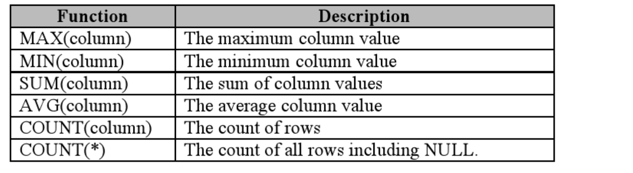
Aggregate functions
Aggregate function performs a calculation on a set of rows and returns a single value

Slide 21
COUNT
COUNT returns the number of rows in a table
Allows to count all rows in a table or rows that match a particular condition
Returns zero if there is no matching row
COUNT(*)
Returns number of rows as a result set of SELECT (both NULLs and no-NULLs)
COUNT(expression)
Returns number of rows that do not contain NULLs
COUNT(DISTINCT expression)
Returns number of unique rows that do not contain NULL values

Slide 22
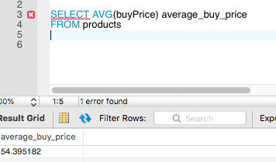
AVG
AVG calculates the average value of a set of values.
Ignores NULL values in the calculation
Example – calculate the average buy price of all products in products table:

Slide 23
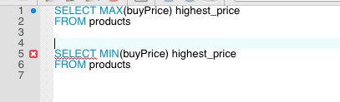
MIN & MAX
MAX returns the maximum value of a set of values.
MIN returns the minimum value of a set of values.

Slide 24
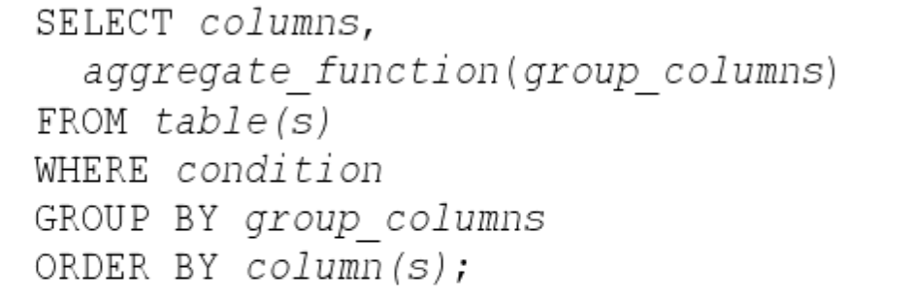
GROUP BY Clause
Group is a set of rows that have the same value for specific columns
GROUP BY clause
Create groups and can apply aggregate functions to these groups (SUM, AVG, MIN, MAX, COUNT)
Returns one row for each group
In a query appears after the WHERE clause and before the ORDER BY clause

Slide 25
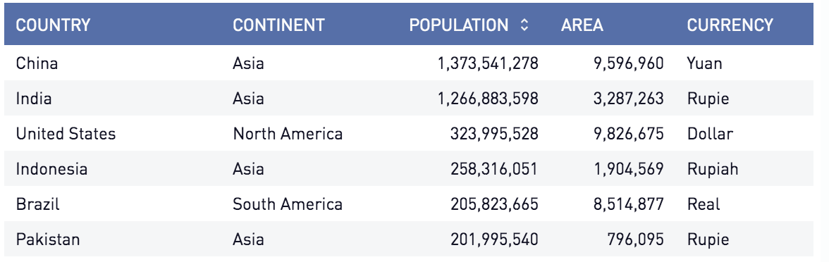
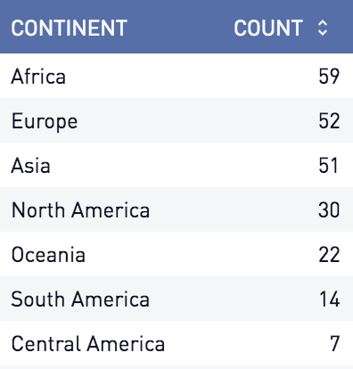
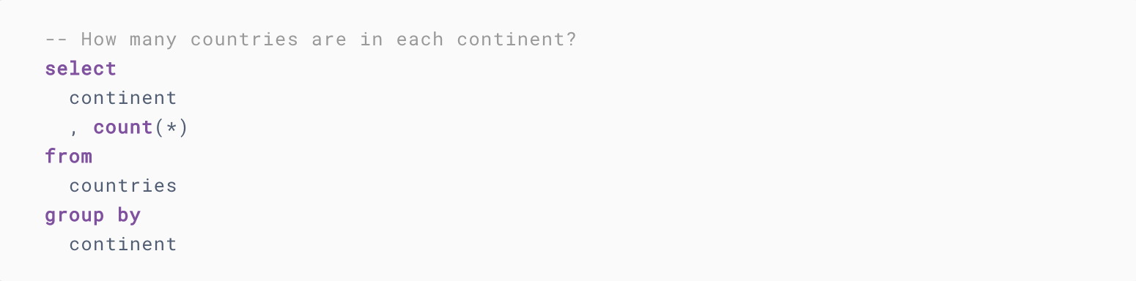
GROUP BY Clause

Slide 26
GROUP BY Clause
Keep in mind when using GROUP BY:
Group by X means put all those with the same value for X in the same row
Group by X, Y put all those with the same values for both X and Y in the same row

Slide 27
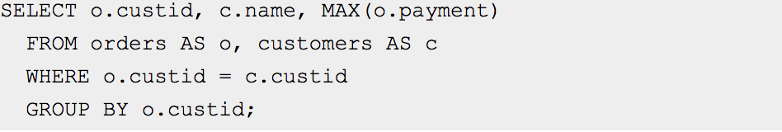
GROUP BY Clause
In standard SQL, a query that includes a GROUP BY clause cannot refer to nonaggregated columns in the select list that are not named in the GROUP BY clause. For example, this query is illegal in standard SQL because the nonaggregated name column in the select list does not appear in the GROUP BY:

Slide 28
GROUP BY Clause
GROUP BY behaves differently in different RDBMS
Oracle won’t allow to use GROUP BY without aggregate function
MySQL will, but you can turn it off:
https://dev.mysql.com/doc/refman/8.0/en/group-by-handling.html
Use sever mode ONLY_FULL_GROUP_BY (disables nonstandard extension)
SET SESSION SQL_MODE=‘ONLY_FULL_GROUP_BY’
“If ONLY_FULL_GROUP_BY is disabled, a MySQL extension to the standard SQL use of GROUP BY permits the select list, HAVING condition, or ORDER BY list to refer to nonaggregated columns even if the columns are not functionally dependent on GROUP BY columns... In this case, the server is free to choose any value from each group, so unless they are the same, the values chosen are nondeterministic, which is probably not what you want”

Slide 29
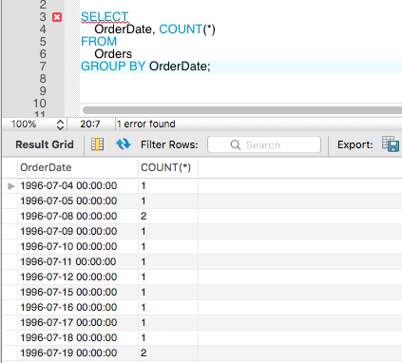
GROUP BY Clause
GROUP BY example with aggregate function (COUNT)

Slide 30
GROUP BY Clause
GROUP BY example with aggregate function
use employees
SELECT salary_year, max_salary, min_salary, max_salary - min_salary as difference
FROM
(SELECT DATE_FORMAT(from_date, '%Y') AS salary_year,
MAX(salary) AS max_salary,
MIN(salary) AS min_salary
FROM salaries
GROUP BY salary_year) as sub_select;

Slide 31
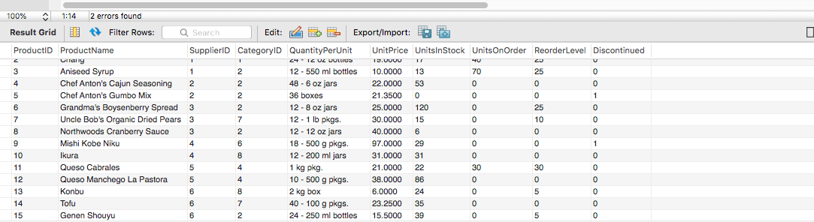
GROUP BY Clause
GROUP BY example with aggregate function (SUM)
Products table:

Slide 32
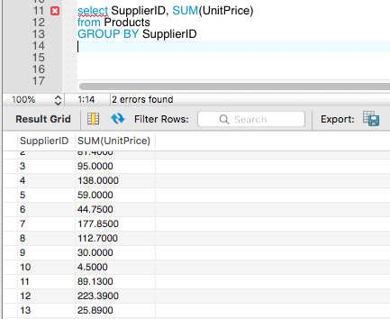
GROUP BY Clause
GROUP BY example with aggregate function (SUM)
Get data for Supplier Id and get the sum of Unit Price for each:

Slide 33
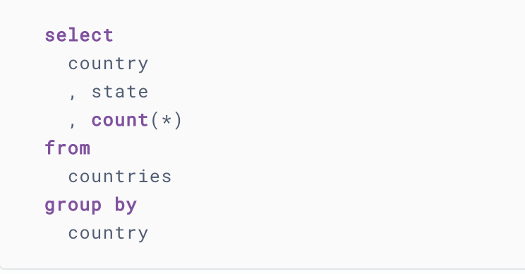
GROUP BY Clause
Group By strange behavior

Slide 34
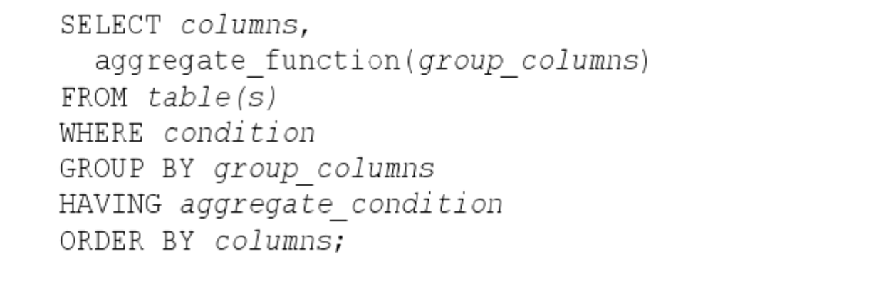
GROUP BY Clause with HAVING
Remember that WHERE condition is used to select individual rows
HAVING clause can be used to select individual groups
Only groups that satisfy the condition in the HAVING clause will be returned
HAVING condition is on the aggregate NOT on the column
If present HAVING must appear after GROUP BY clause

Slide 35
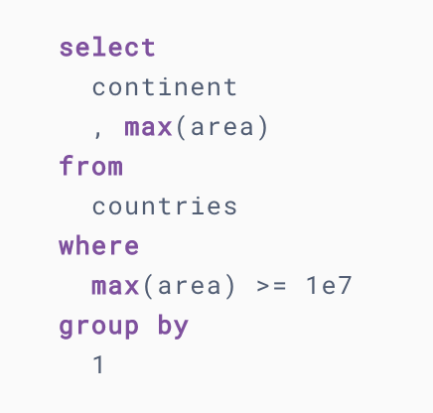
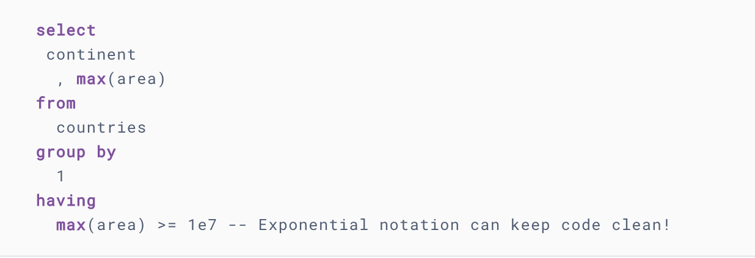
GROUP BY Clause with HAVING
You will discover that the WHERE clause cannot be used on an aggregation:

Slide 36
GROUP BY Clause with HAVING
A similar MySQL extension applies to the HAVING clause.
In standard SQL, a query cannot refer to nonaggregated columns in the HAVING clause that are not named in the GROUP BY clause. To simplify calculations, a MySQL extension permits references to such columns. This extension assumes that the nongrouped columns have the same group-wise values. Otherwise, the result is indeterminate.

Slide 37
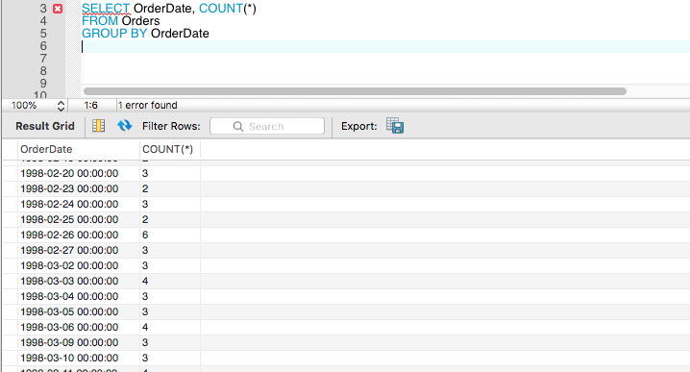
GROUP BY Clause with HAVING
Example:

Slide 38
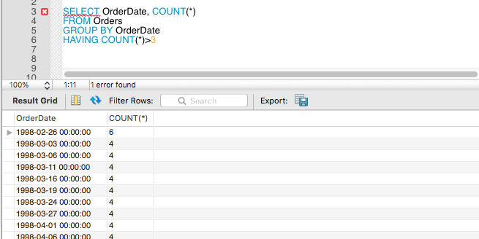
GROUP BY Clause with HAVING
Let’s select number of orders for a particular order date
And applying condition (HAVING) so that the number of orders for that particular date is > 3

Slide 39
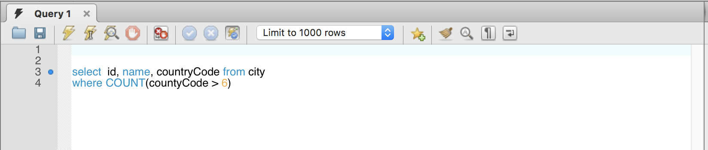
Aggregate Rule
You cannot apply aggregate as a WHERE clause, you will get an error

Slide 40
Types of Join
JOIN clause instructs SQL to join data from two or more tables
Produces only related rows from the joined tables
Inner joins are the most common
Returned rows must match join conditions
Outer join returns all rows in first table and only matching rows from second table
Natural join combines tables where columns of the same name are equal
Cross join returns one row for each row in the first table, with each row in second table
Union combines rows from one or more tables

Slide 41
Types of Join

Slide 42
Writing Joins
ON keyword used to specify criteria for the joins
Inner joins are the most common
Returned rows must match join conditions
OUTER/INNER keywords are optional
LEFT OUTER JOIN returns all rows of the table on the left side of statement and only matching rows from the table on the right side of statement
RIGHT OUTER JOIN returns all rows of the table on the right side of statement, and only matching rows on the left side of statement

Slide 43
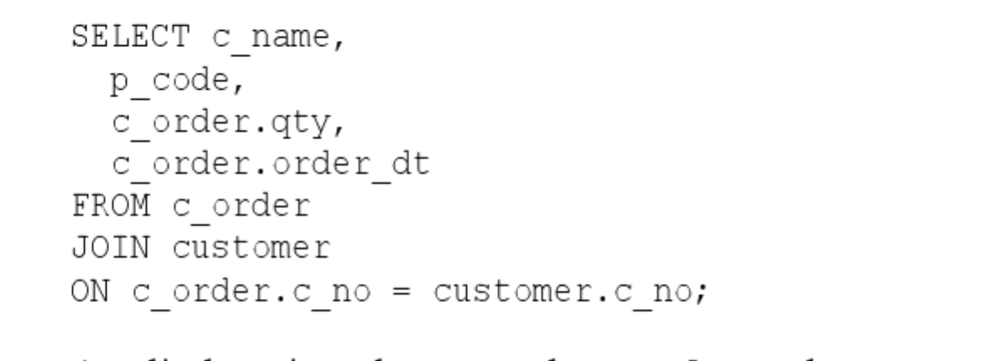
Inner Join
JOIN clause relates rows from one or more tables
Produces only related rows from the joined tables
Remember that PRIMARY KEY is a column or set of columns that uniquely identifies every row in a table.
And FOREIGN KEY is a column or set of columns that used to relate to the primary key of another table
Joining – process of using PK/FK to relate rows from tables

Slide 44
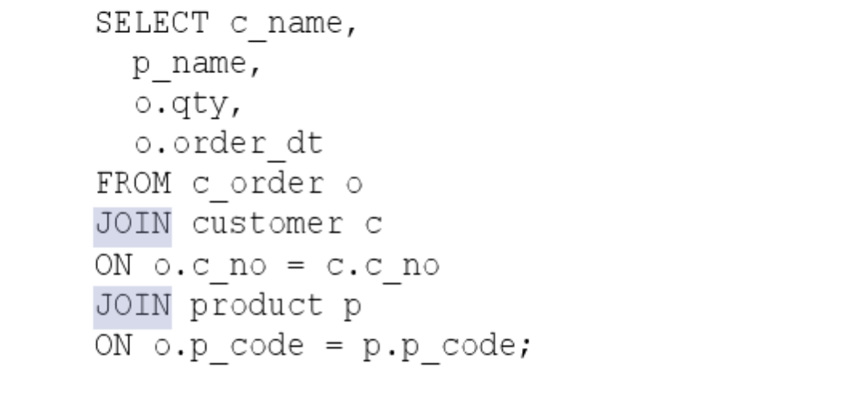
Joining Multiple Tables
JOIN more than two tables – join two tables at the time

Slide 45
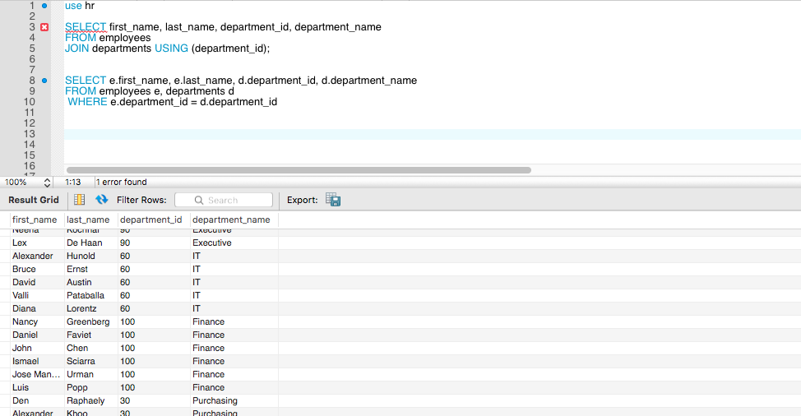
Joining Multiple Tables
This is the same statement:

Slide 46
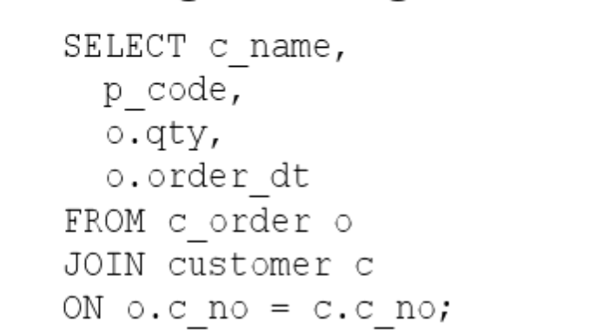
Using Table Aliases
Different tables can have columns with identical names
Need to qualify it with its table
Use table aliases to qualify a column in this case

Slide 47

Using Table Aliases
See what happens if we don’t use table aliases
Error Code: 1052. Column 'department_id' in field list is ambiguous

Slide 48
Table Aliases vs Column Aliases
Remember that we can use aliases for columns using AS keyword
Column alias can be created without AS keyword, but we get better readability with it
p_name AS product_name instead of p_name product_name
Table aliases CANNOT use the AS keyword

Slide 49
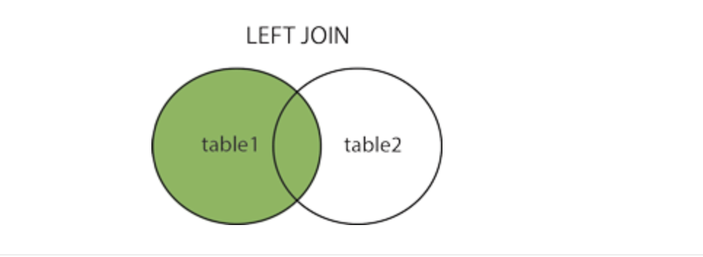
LEFT OUTER JOINS
LEFT JOIN returns all records from left table (table 1) and the matched records from right table (table 2).
The result is NULL from the right side if there is no match

Slide 50
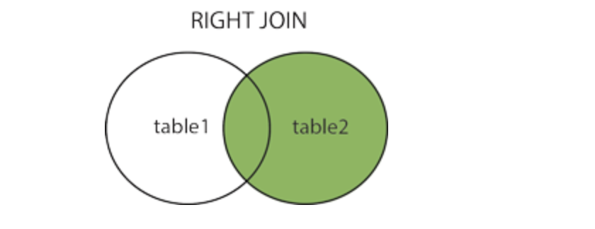
RIGHT OUTER JOINS
RIGHT JOIN returns all records from right table (table 1) and the matched records from left table (table 2).
The result is NULL from the left side if there is no match

Slide 51
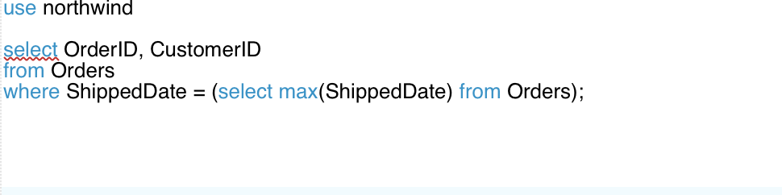
Subqueries
Subquery is a query nested within another query (SELECT within SELECT)
Allow us to query the results of other queries to form complex requests
Single-row subqueries – return a single value
Return value of the subquery is compared with a column of the outer query using one of the comparison operators
Outer query – query that contains subquery
Inner Query – subquery itself

Slide 52
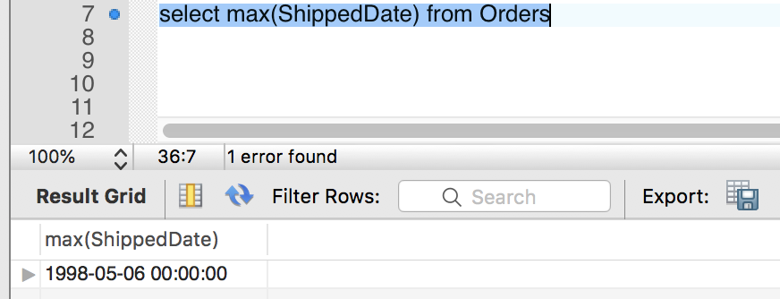
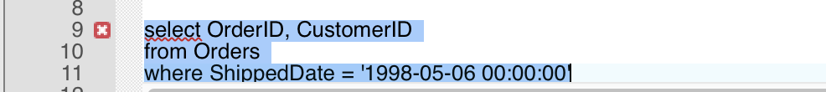
Subqueries
Let’s deconstruct it:
(1) Using max to return maximum shipping date in the Orders table
(2) Then this max date is used in outer query to compare with ShippedDate

Slide 53
Subqueries
Rules:
A subquery must always appear within parentheses
Can embed a subquery inside another query
If the outer query expects a single value or a list of values from a subquery, the subquery can only use one expression or column name in its select statement
When you use the result from a subquery to join a table in a JOIN operation, no index can be used on the join column(s). This is because subquery first generates result on the fly and then the result is used in the join

Slide 54

Subqueries
If this query returns more than one row, you will get an error:

Slide 55

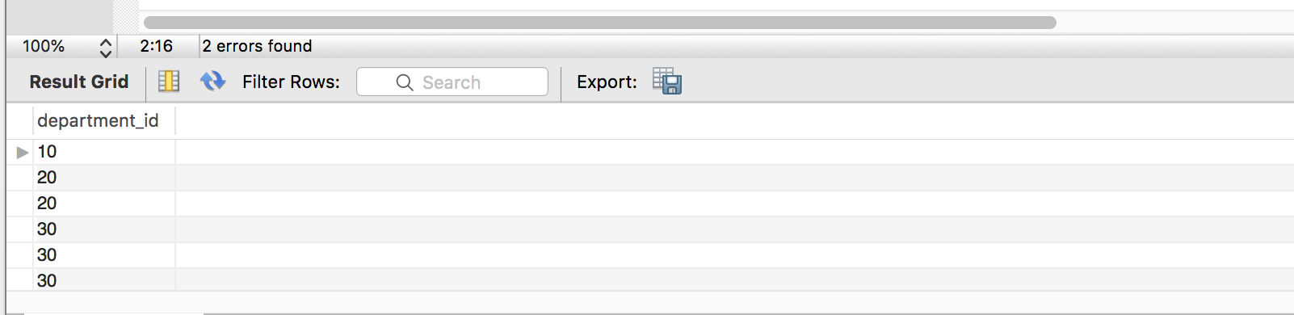
Multiple-Row Subqueries
Subquery that returns more than one value
Instead of using a comparison operator, you will use IN or NOT IN in a where clause

Slide 56
Subqueries cont.
Subquery can appear in a:
SELECT clause
FROM clause
WHERE clause

Slide 57
Subqueries cont.
Advantages of using subquery:
Subqueries structure a complex query into isolated parts - complex query can be broken down into a series of logical steps for easy understanding and code maintenance.
Subqueries allow you to use the results of another query in the outer query
In some cases, subqueries can replace complex joins and unions and subqueries are easier to understand
Disadvantages of using subquery:
Database server (optimizer) may need to perform additional steps (sorting), can be slower. If you can re-write with JOIN do so
When you use JOIN optimizer gets data more efficiently

Slide 58
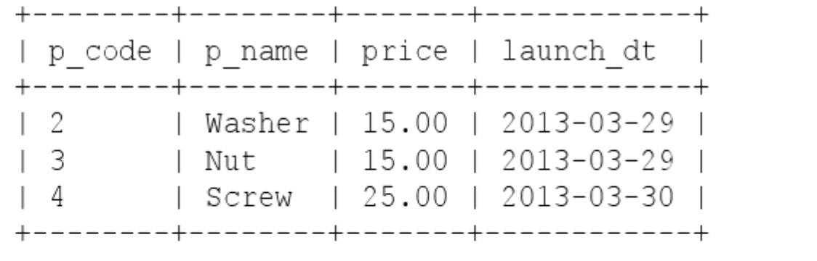
Special Functionality – Limiting Number of Rows
Limiting number of Rows – LIMIT clause

Slide 59
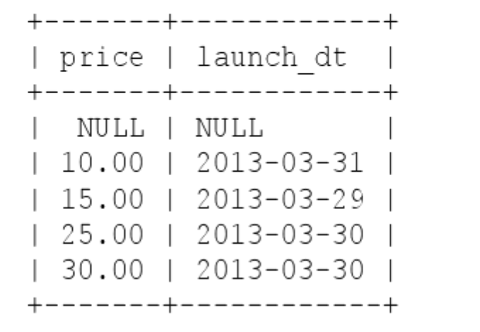
Special Functionality – DISTINCT on Multiple Columns
When a query returns multiple columns, two rows are considered duplicates if all their columns have the same values. They are not duplicates if only one column has the same values

Slide 60
CASE Statement
CASE expression allows for dynamic query output where column value vary depending on the value of the column
CASE:
Simple
Searched

Slide 61
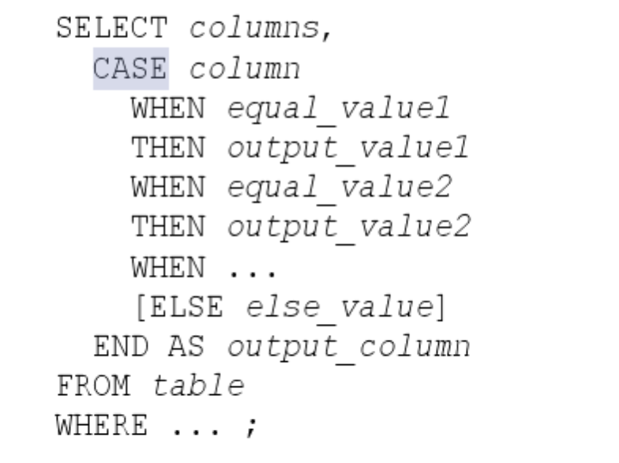
CASE Statement - Simple
Simple CASE – column_name is compared to equal_values in the WHEN clause
If column_name matches a WHEN value, the value right after the THEN clause is returned and CASE process stops

Slide 62
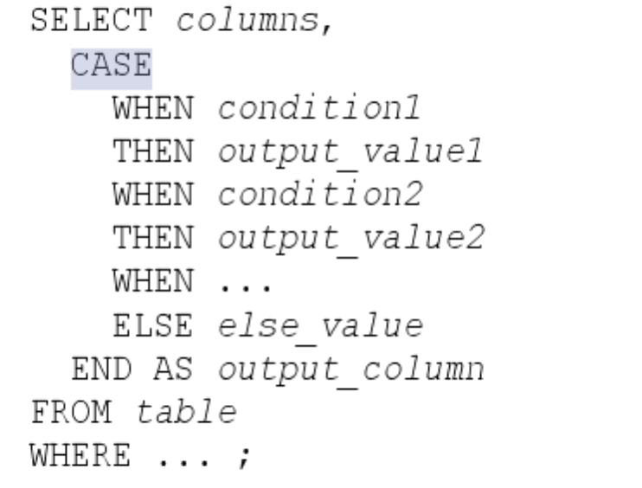
CASE Statement - Searched
Searched CASE – simple compares column with various values, whereas Searched can be any condition.
If column_name matches a WHEN value, the value right after the THEN clause is returned and CASE process stops

Slide 63
Views
View – a predefined query
Create and use views for the following purposes:
Hiding table columns (for security protection)
Presenting pre-computed columns (instead of table columns)
Hiding queries (so that query outputs are available without running the queries)

Slide 64
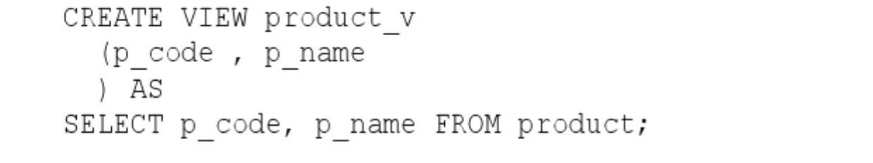
Views
Create view using CREATE VIEW statement:
CREATE VIEW view_name (columns) AS SELECT…;
Within database a view name must be unique among all tables and all views

Slide 65
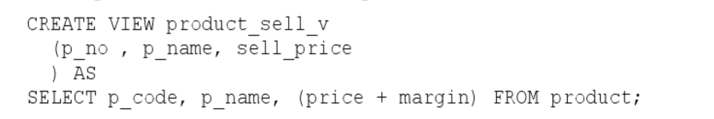
Views
Views can perform computations

Slide 66
Triggers
Database objects with a name
Activated (“fired”) when table data is modified
Trigger features:
Examining data before it is inserted/updated/deleted
Data filter by changing data if it out of range before insert/update
Modifying how INSERT, UPDATE, DELETE behave
Log messages

Slide 67
Triggers
Use CREATE TRIGGER statement:
CREATE TRIGGER trigger_name
{BEFORE | AFTER}
{INSERT | UPDATE | DELETE|
ON table_name
FOR EACH ROW
triggered_statement

Slide 68
Example
CREATE TRIGGER County_CD AFTER DELETE
On County
FOR EACH ROW
INSERT INTO DeletedCounty (ID, CODE)
VALUES (OLD.ID, OLD.CODE)

Slide 69
Metadata
Data that describes structure of the database (data about data)
Data Dictionary – Metadata
MySQL metadata is stored in INFORMATION_SCHEMA database tables
Contain data about all objects managed by MySQL
Use MySQL skills gained so far to query it
Can only READ metadata, can’t change it

Slide 70


Metadata - tables
Tables table stores names and other information for all your tables
For example, here are the tables in WORLD database

Slide 71


Metadata - Columns
Columns table stores information about columns
For example, here are the columns in WORLD database table city

Slide 72
MySQL Transactions
A collection of data manipulation execution steps that are treated as a single unit of work
Use to group multiple statements
Use when multiple clients are accessing data from the same table concurrently
Can be just one or many
All or none of the steps succeed
Execute if all steps are good
Cancel if steps have error or are incomplete
ACID compliant

Slide 73
Remember ACID
Atomic
All statements execute successfully or are canceled as a unit
Consistent
Database that is in a consistent state when a transaction beings, is left in a consistent state by a transaction
Isolated
One transaction does not affect another
Durable
All changes made by transaction that complete successfully are recorded properly in the database
Changes are not lost

Slide 74
MySQL Transactions
Commit
Indicates the end of transaction and lets database know to make permanent change
Rollback
Revert all changes in transaction
Savepoint
Can set programmatic point that allows you to rollback part of a transaction

Slide 75
MySQL Transactions
Auto-commit
Enabled by default
SET Autocommit
Enables or disables auto commit for your session
START Transaction or BEGIN
Starts transaction

Slide 76
Database locks
MySQL will lock records to make sure other processes don’t change the data
SELECT FOR UPDATE, UPDATE, DELETE
Within a transaction these DML will lock records
As transactions take place other sessions that want to modify same records will wait until lock is released
Within a transaction these DML will lock records

Slide 77
Deadlocks
Classic problem of transactional databases
When multiple transactions need data that the other has already locked
MySQL detects and aborts (rollback) one of the transactions and allows the other to complete
Deadlock can occur when:
Transactions acquire locks on multiple tables, but in opposite order
There are multiple transactions and one is waiting for the other(s) to complete in order to form a cycle. Example – T1 is waiting for T2, T2 is waiting for T3 and T3 is waiting for T1

Slide 78

Transaction Example: Deadlocks

Slide 79

Implicit Locks

Slide 80
MySQL Replication
Replication enables data from one MySQL database server (master) to be copied to one or more MySQL database servers (the slaves).
Asynchronous by default;
Idea is to use secondary servers on your infrastructure for either reads or other administrative solutions.

Slide 81

MySQL Replication

Slide 82
MySQL For Data Science
Can use MySQL for advanced data analytics
Can load large quality of data sets into MySQL
Can perform data cleansing
Can utilize indicator variables (1 or 0) for columns for machine learning algorithms
You can convert columns to rows for data to generate meaningful summaries
You can perform descriptive statistics
Can use centering and scaling – technique to normalize continuous variables to be in the same range to prepare data for machine learning

Slide 83
MySQL for Analytics
Can use MySQL functions to normalize continuous variables
Example: STDDEV()
Returns population standard deviation of the expression
Returns NULL if there is no matching value
Example: VARIANCE()
Returns population standard variance of the expression
Also use MIN(), AVG(), MAX()
Returns population standard deviation of the expression
Returns NULL if there is no matching value

Slide 84
“SQL For MySQL: A Beginner’s Tutorial”
Code samples: https://www.w3resource.com/

Slide 85
LAB (If you do not finish the lab in class – take it home as homework) More on JOINS: https://www.cloudways.com/blog/how-to-join-two-tables-mysql/

Slide 86

HR SCHEMA

Slide 87

NORTHWIND SCHEMA

Slide 88

Cardinality/Ordinality
Cardinality – maximum number of times an instance in one entity can relate to instances of another entity.
Ordinality – minimum number of times an instance in one entity is associated with an instance in the related entity.

